Slide 1

Lecture 6
Function as an Object
Function as a data typ

Slide 2

Agenda
Functions as a Data Type
Storing Function in a Variable
Passing Functions as an Input

Slide 3
Functions as a Data Type

Slide 4

Function
A sub-program that perform a specific task
Takes in some input and give some output (returning values or perform some actions)

Slide 5
Data Type
Represent a data structure
  can be stored in a variable
  can be passed to a function as an input

Slide 6
Function as an object/data type
Equals to “Function as first class citizen”, or “first class function”
In Java (old Java), or C++, function is a special concept on its own
In Python and Javascript (and other languages), functions is a type of “data” and could be store in a “variable”
Thus, it could be passed into functions as an input

Slide 7
Storing function in a variable

Slide 8

Still remember how to define a function?
a
Add
a + b
b
JS Code
Diagram View

Slide 9
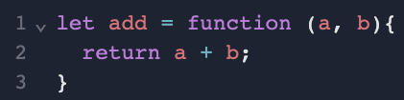
A different way of defining a function
a
Add
a + b
Old Way
b
Diagram View
Storing a function in a variable

Slide 10
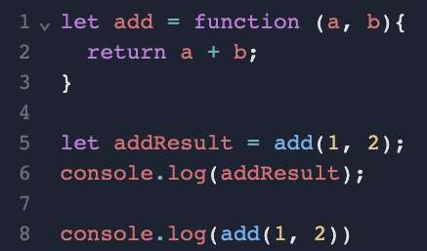
Using the function variable

Slide 11
Passing Functions as an Input

Slide 12
Passing Functions as Function Input
When we want some part of the function logic to be “defined” by an input
The function caller can decide a part of the function logic

Slide 13
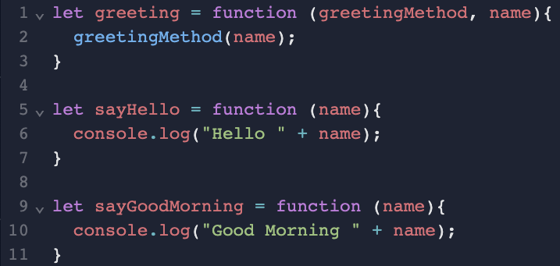
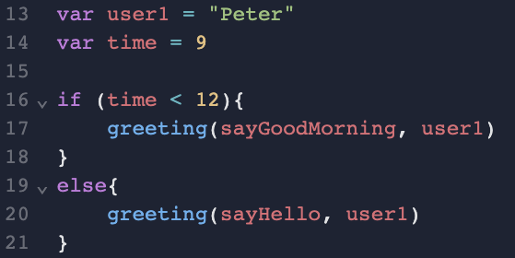
Passing Functions as Function Input
Storing Function in a Variable

Slide 14
Passing Functions as Function Input
Storing Function in a Variable
In Main Function
(right hand side)
Inside greeting Function
Actual Executed Code inside greeting Function
Input Parameter | Value
name | Peter
greetingMethod | sayGoodMorning
Before noon
greeting(sayGoodMorning, user1)
sayGoodMorning(name)
Input Parameter | Value
name | Peter
greetingMethod | sayHello
After noon
greeting(sayHello, user1)
sayHello(name)

Slide 15
Why do we want to have functions as input?
To have different handling after executing the main logic in a function
Example: If I have an "add" function, after calculating the the sum, how to handle it?
  Print it out?
  Update the user interface - web page?
  Store it in a file?
  Send in email?
  Send in Whatsapp?

Slide 16
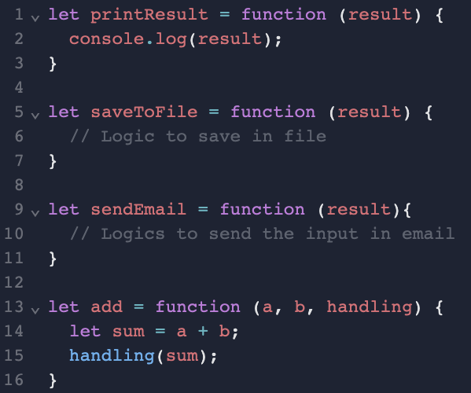

Why do we want to have functions as input?
Different Use Case Scenarios:

